Slide 1
Lesson 5: Stacking and Blending

Slide 2
Today's Agenda
Combine classifiers
Stacking
Blending

Slide 3
Learning Objectives
By the end of this session, you should be able to:
Describe the theory of how ensemble learning reduces errors.
Use stacking to improve model performance.
Use blending to improve model performance.

Slide 4
Weak Learner & Strong Learner
A weak learner: it can make predictions (slightly) better than random guessing.
Weak learners have high bias and cannot solve hard learning problems.
e.g., naïve Bayes, logistic regression, decision stumps (decision trees of depth 1)
A strong learner: it has arbitrarily small error rate.
Strong learners are our goal of machine learning.
e.g., random forest, deep neural networks

Slide 5
Can we turn weak learners into a strong one?
Weak Learner 1
Weak Learner 2
Weak Learner 3
Strong Learner
…
Weak Learner K
YES, ENSEMBLE LEARNING

Slide 6
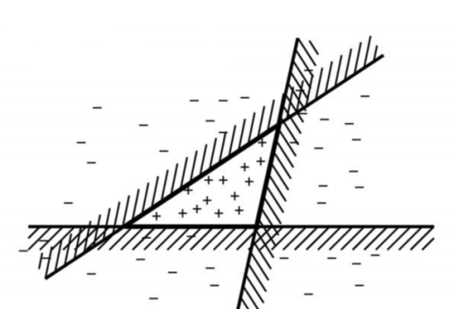
Ensemble Learning Intuition
Fable of blind men and elephant
Combine 3 linear classifiers

Slide 7
Ensemble Learning
Instead of learning a single classifier, we learn a set of classifiers.
Combine the predictions of multiple classifiers to produce the final prediction.
How do we learn a set of classifiers?
How do we combine all the classifiers?

Slide 8
Why do ensembles work?
Suppose there are 25 classifiers where each classifier has an error rate of 0.35.
Assume classifiers are independent: a mistake from one classifier does not depend on the predictions from other classifiers.
In practice they are NOT completely independent.
Majority Voting: The ensemble makes a wrong prediction if the majority of the classifiers predict the wrong prediction.
What is the probability that the ensemble makes a wrong prediction? (hint: 13 or more classifiers make wrong predictions).

Slide 9
Why do ensembles work?
Suppose there are 25 base classifiers
Each classifier has error rate, ε = 0.35
Assume classifiers are independent
Probability that the ensemble classifier makes a wrong prediction:

Slide 10
How it works
Majority vote
Suppose we have 5 completely independent classifiers…
If accuracy is 70% for each
(.7⁵)+5(.7⁴)(.3)+ 10 (.7³)(.3²)
83.7% majority vote accuracy
101 such classifiers
99.9% majority vote accuracy
Note: Binomial Distribution: The probability of observing x heads in a sample of n independent coin tosses,
where in each toss the probability of heads is p, is

Slide 11
Value of Ensembles
“No Free Lunch” Theorem
No single algorithm wins all the time!
When combing multiple independent and diverse decisions each of which is at least more accurate than random guessing, random errors cancel each other out, correct decisions are reinforced.

Slide 12
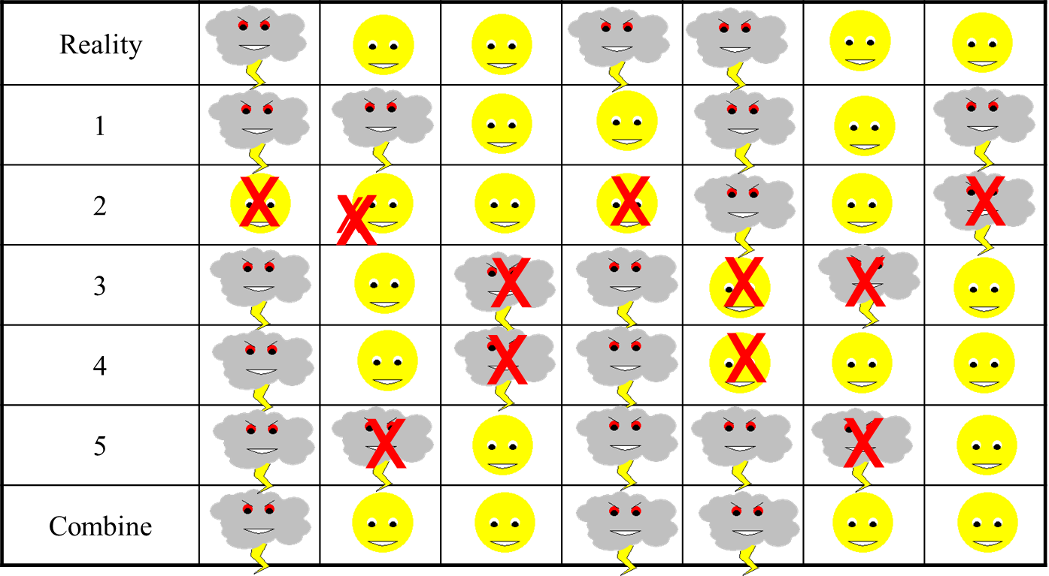
Example: Weather Forecast

Slide 13
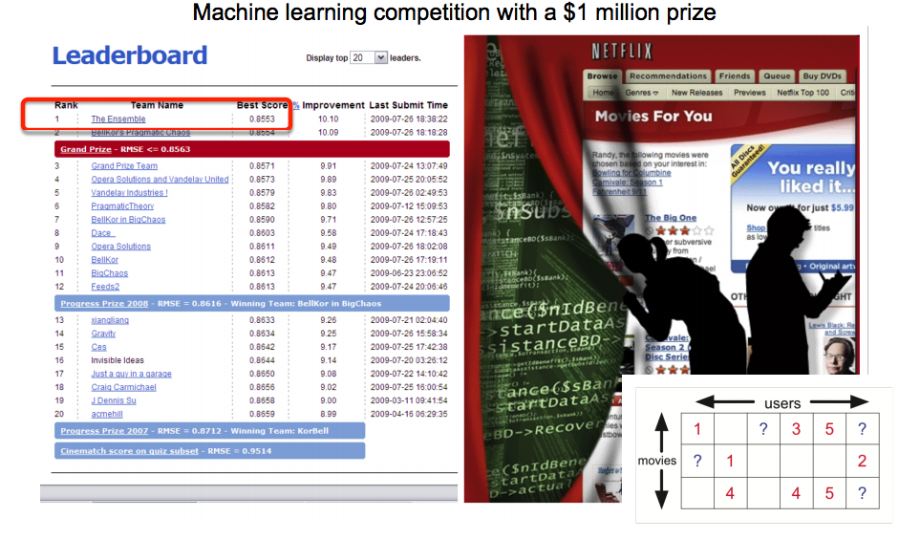
Ensemble Learning in Netflix Prize
The Ensemble was an ensemble solution of teams which had been competing individually for the prize.

Slide 14
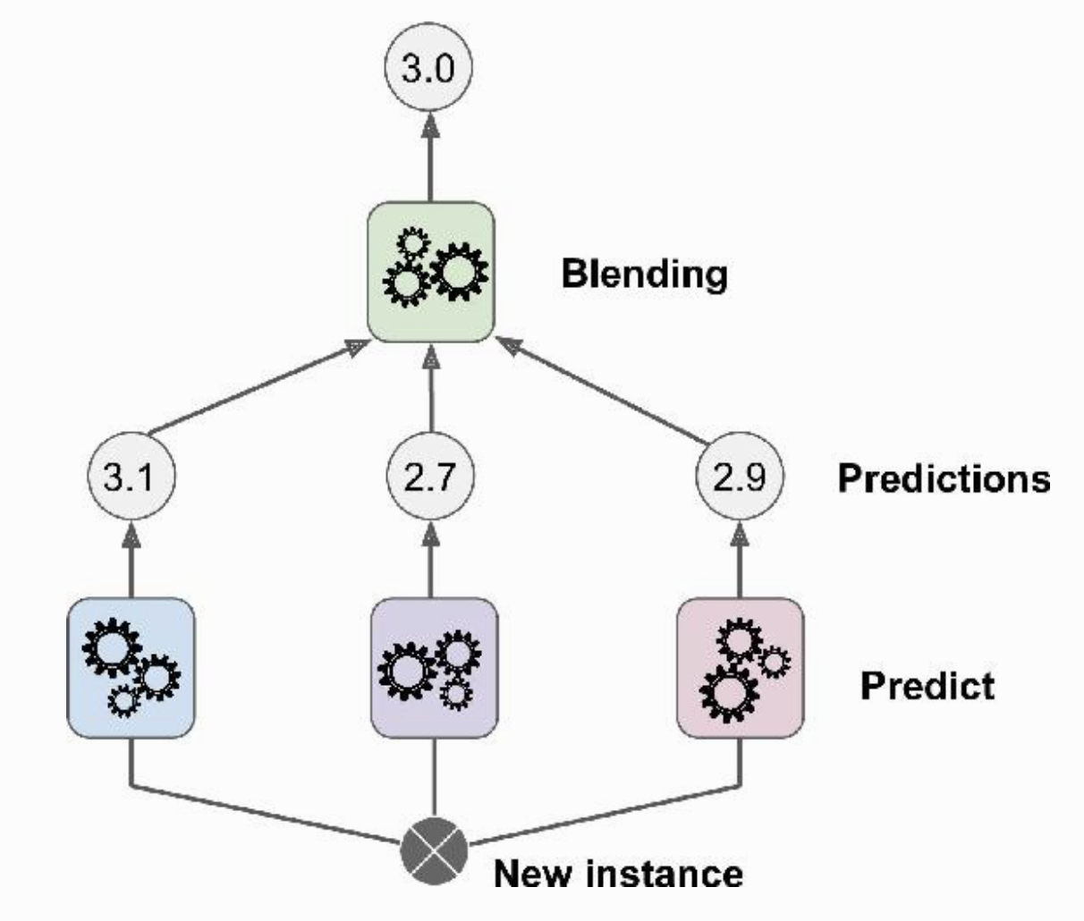
The Idea of Stacking
Instead of using trivial functions (such as majority voting / averaging) to aggregate the predictions of all predictors in an ensemble, we train a model (aka blender) to perform this aggregation.

Slide 15
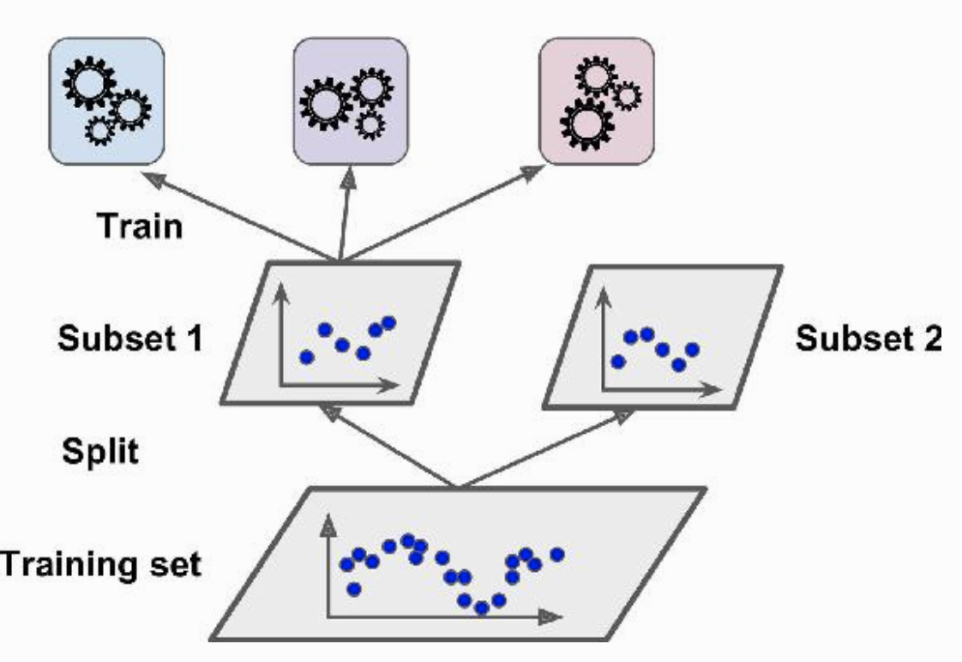
Training stacked model – Step 1
The training set is split in two subsets.
The first subset is used to train the predictors in the first layer.
The second subset is used to train the blender in the second layer.

Slide 16
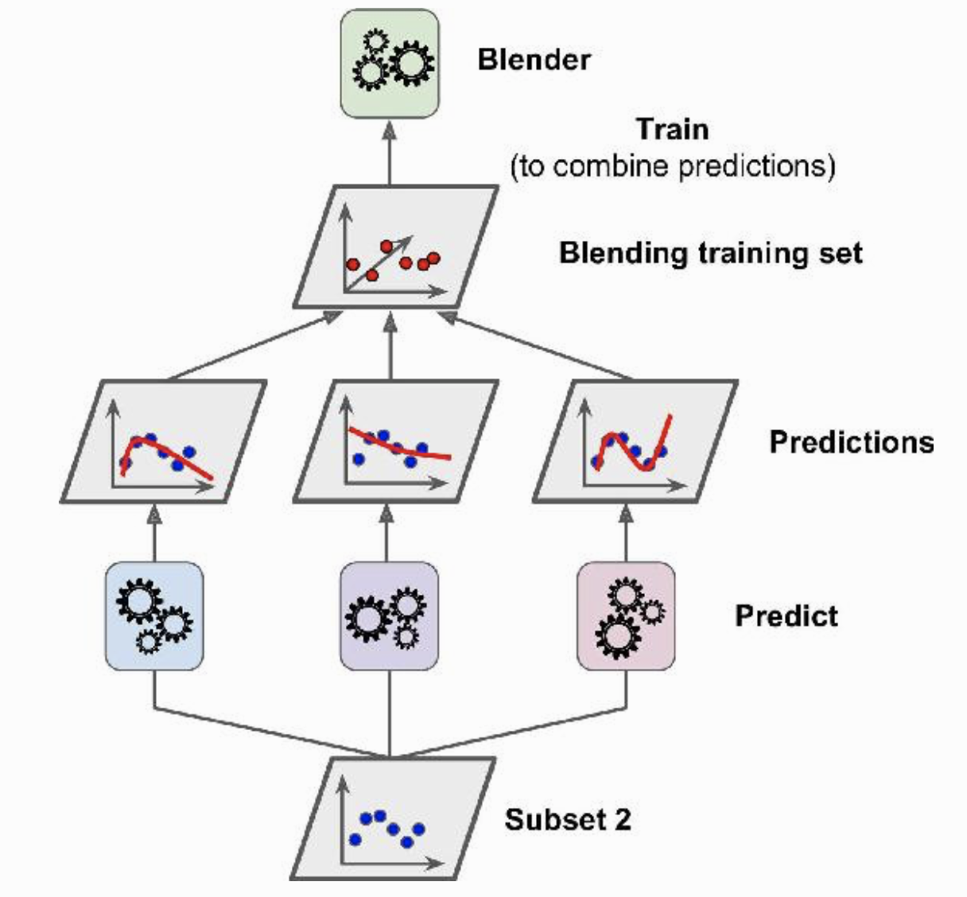
Training stacked model – Step 2
The first layer predictors are used to make predictions on the second subset.
Create a new training set using these predicted values as input features.
The blender is trained on this new training set, so it learns to predict the target value given the first layer’s predictions.

Slide 17
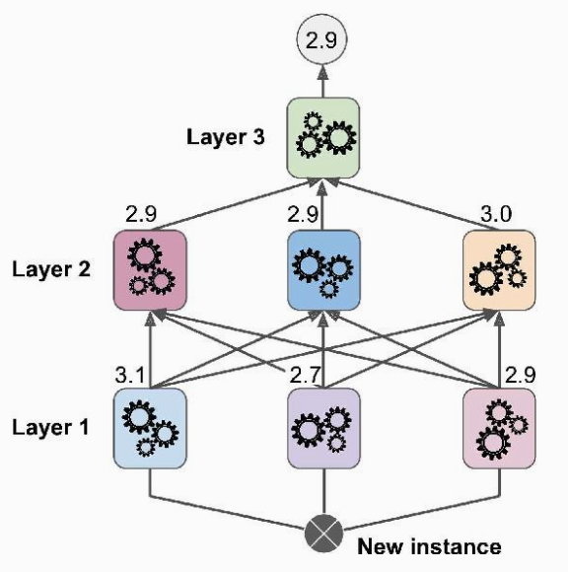
Multilayer Stacking Ensemble
We can easily extend the 2-layer stacking model to multi-layer stacking.
Split the original training data into K subsets for a K-layer stacking model.
The i^{th} subset of the data is used to learn the blenders in the i^{th} layer to avoid data leakage.

Slide 18
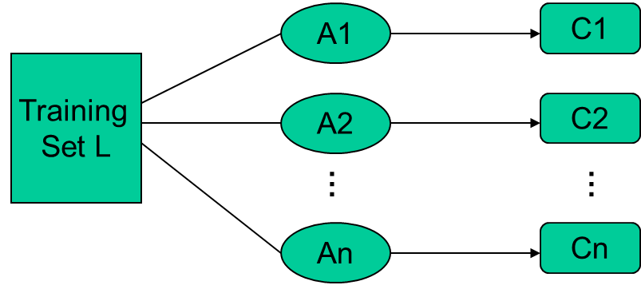
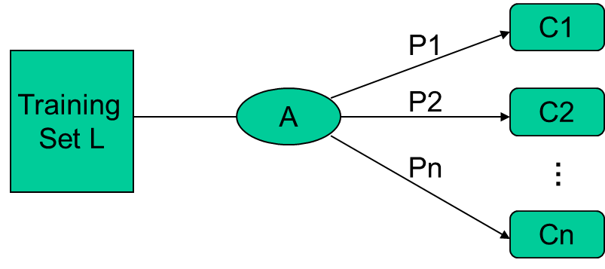
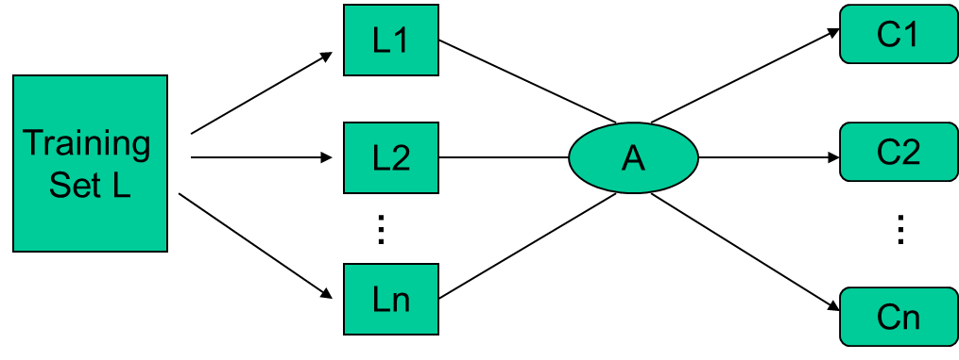
Types of Ensemble Learning
Different learning algorithms
Algorithms with different choice for parameters
Data set with different features (e.g. random subspace)
Data set = different subsets (e.g. bagging, boosting)

Slide 19
General Idea
Eick: Ensemble Learning

Slide 20
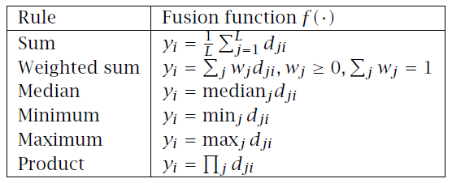
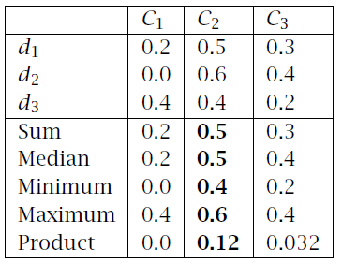
Fixed Combination Rules
Lecture Notes for E Alpaydın 2010 Introduction to Machine Learning 2e © The MIT Press (V1.0)

Slide 21
How to Combine Classifiers
Voting:
Classifiers are combined in a static way
Each base-level classifier gives a (weighted) vote for its prediction
Plurality vote: each base-classifier predict a class
Stacking: a stack of classifiers
Classifiers are combined in a dynamically
A machine learning method is used to learn how to combine the prediction of the base-level classifiers.
Top level classifier is used to obtain the final prediction from the predictions of the base-level classifiers
Example
Example

Slide 22
Notebook Time

Slide 23
What is the Main Challenge for Developing Ensemble Models?
The main challenge is not to obtain highly accurate base models, but rather to obtain base models which make different kinds of errors.
For example, if ensembles are used for classification, high accuracies can be accomplished if different base models misclassify different training examples, even if the base classifier accuracy is low. Independence between two base classifiers can be assessed in this case by measuring the degree of overlap in training examples they misclassify (|A ∩B|/|A∪B|)—more overlap means less independence between two models.

